Slide 1

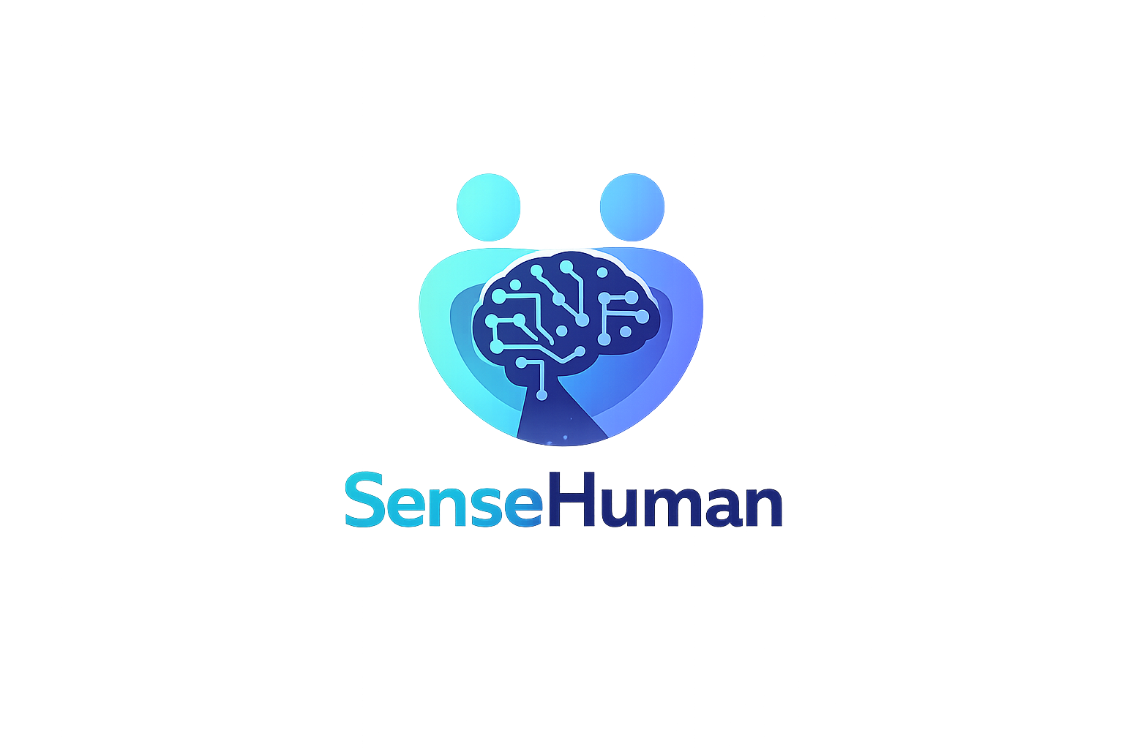
Notes:
Hello, we will present our project, which we call SenseHuman.

Slide 2
Motivation
What it is & why it matters
AI-driven healthcare is growing rapidly
Patients generate large amounts of health data
Different patient groups have different needs
  e.g., cardiovascular and chronic disease patients
A need to handle data while adapting to different patients
Notes:
Today, AI-driven healthcare is growing rapidly, and patients generate large amounts of health data.
At the same time, different patient groups have different needs. For example, cardiovascular patients and patients with chronic diseases may require different types of monitoring and support.
Therefore, we saw that there is a need to develop solutions that can handle large amounts of data while also adapting to different patient needs.

Slide 3
Problem
Fragmentation – existing solutions work separately rather than together
  e.g., symptom tracking apps, wearables, clinical AI tools
Important to combine:
  quantitative data: e.g., stress level
  qualitative data: e.g., how the patient feels
A risk on both sides
  patients may be uncertain of their true condition ⟹ inaccurate self-assessment
  doctors may get an incomplete picture ⟹ suboptimal clinical decisions
Notes:
The core problem we want to tackle is fragmentation: solutions often work separately rather than together, such as symptom tracking apps, wearables, and clinical AI tools.
As a result, few systems combine both quantitative data, such as stress level, and qualitative data, such as how the patient feels.
This creates risks on both sides. On one hand, patients may be uncertain of their true condition, which can lead to inaccurate self-assessment. On the other hand, doctors may only see part of the picture, which can lead to sub-optimal clinical decisions.

Slide 4
Suggested solution
AI-driven Clinical decision support SYSTEM
💡 Integrating patient narratives and sensor data for clinical decision support
Target users: patients with specific diseases or injuries
  e.g., heart disease, knee problems
Mobile application together with wearable sensors
  Patient input + sensor data → AI processes information → Clinical insights
Notes:
Our suggested solution is an AI-driven clinical decision support system that integrates patient narratives and sensor data.
The target users are patients with specific diseases or injuries, such as heart disease or knee problems.
The system works through a mobile application and wearable sensors. By combining patient input with objective sensor data, the AI can process the information and generate clinical insights that support better decision-making.

Slide 5
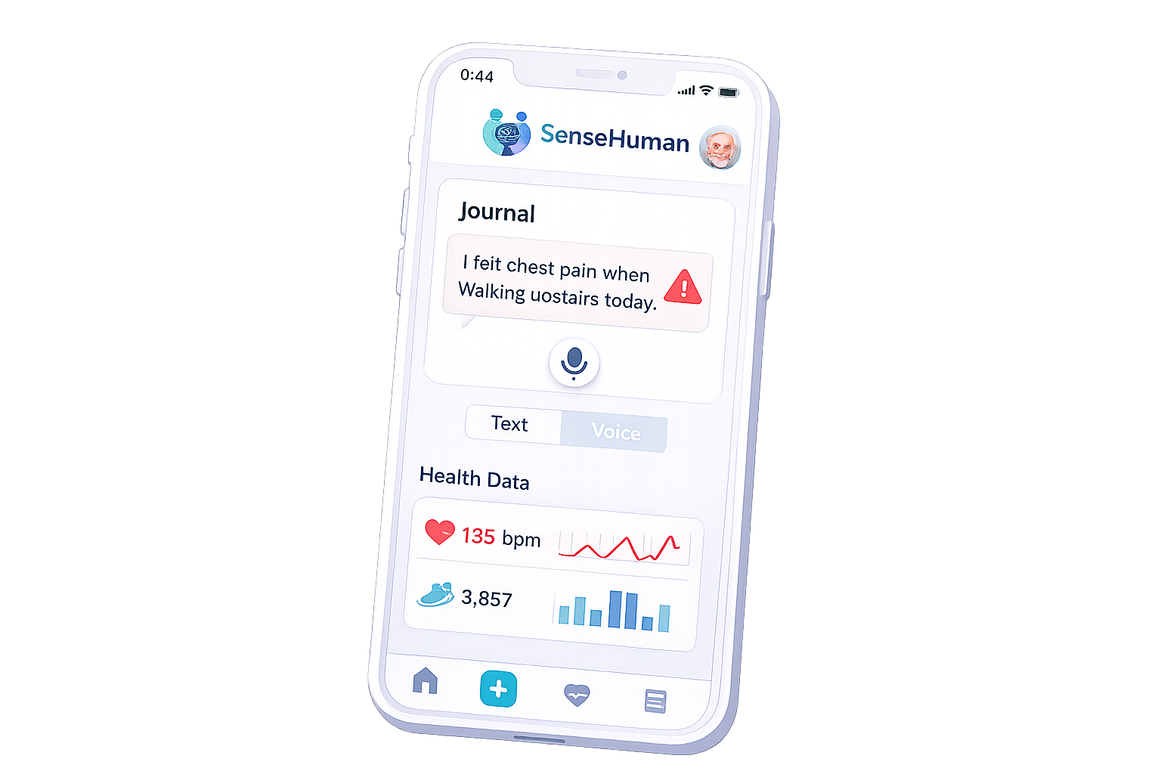
Suggested solution
Patient-side
Text & voice journal
Wearable sensor integration
  e.g., smartwatch, armband
Simple patient interaction
User-friendly interface
Easy daily symptom and health tracking
Notes:
For the patient-side of our solution, patients can record their condition using either text or voice journals, which makes the system flexible and easy to use.
The app also integrates wearable sensors, such as a smartwatch or armband, to collect objective health data.
The goal is to make the interaction simple and intuitive, so patients can use it regularly without difficulty.
In this way, the system supports easy daily tracking of both symptoms and health signals.

Slide 6
Suggested solution
AI processing
data = patient journal + sensor measurements
Journal entry triggers AI processing
Sensor data is analyzed within the time frame around the journal entry
AI combines subjective and objective data ⟹ better understands the context
Notes:
In the AI processing step, the data includes both patient journal entries and sensor measurements.
The process starts when the patient creates a new journal entry.
At that point, the sensor data is then analyzed within a relevant time window around the journal entry.
This way, the system combines the patient’s subjective input with objective sensor data, allowing the AI to better understand the context.

Slide 7
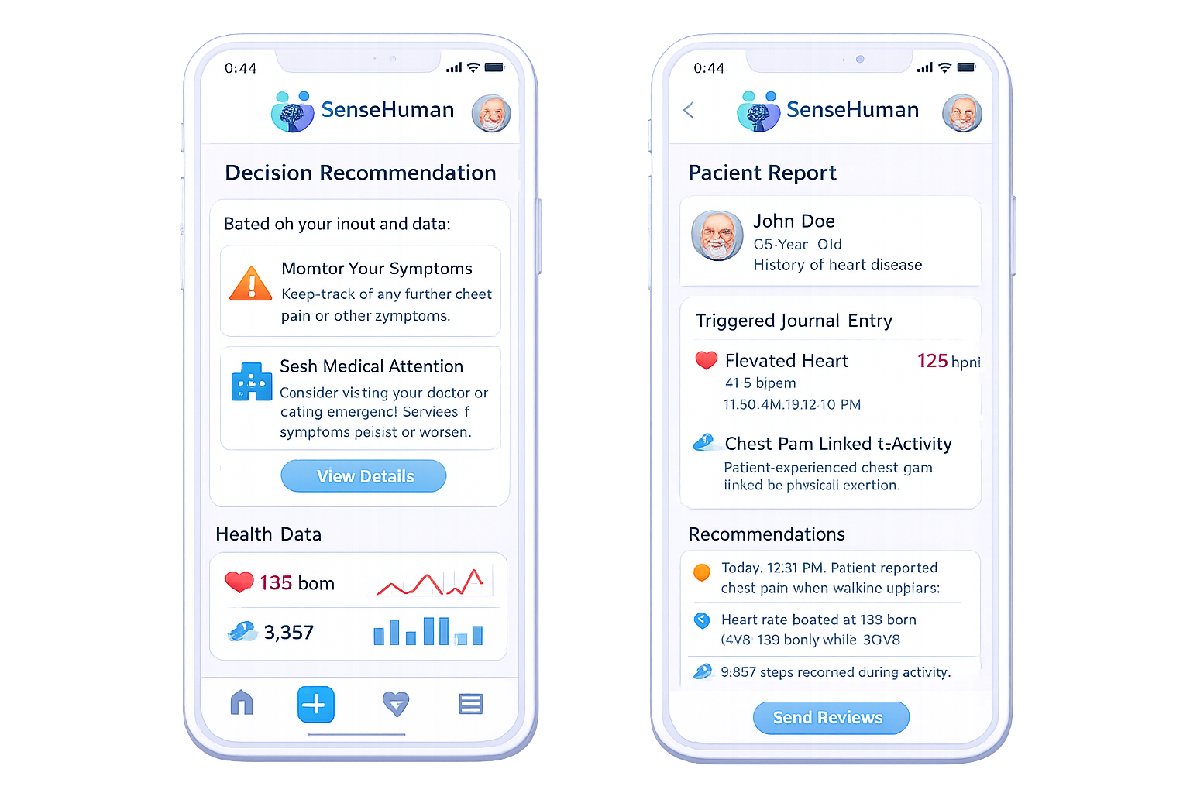
Suggested solution
Output: clinical decision support
For patients:
  personalized recommendations based on the journal entries, sensor data, and specific condition
For doctors:
  summarized patient context and health data
Shared access for both patient and doctor
Supports better communication and clinical decision-making
Notes:
The output of the system is presented in two ways:
For the patient, the AI provides personalized recommendations based on patterns in the journal entries, sensor data, and the specific condition.
For the doctor, the system creates a clear summary of the patient’s context and relevant health data.
This means both the patient and the doctor can access useful information from the same platform.
In that way, the system improves communication and supports better clinical decision-making.

Slide 8
Method
Short-term phase:
  interviews with patients and healthcare professionals
  case studies with selected disease groups
Long-term phase:
  development of an integrated app
  implementation of AI models for data structuring and analysis
  testing in real-world scenarios
Notes:
Our method is separated into two phases:
In the short term, we focus on understanding the real needs of users through interviews with patients and healthcare professionals, as well as case studies with selected disease groups.
In the long term, the goal is to develop an integrated application, implement AI models for structuring and analyzing the data, and test the solution in real-world scenarios.
This approach helps us move step by step from user needs to a practical and validated system.

Slide 9
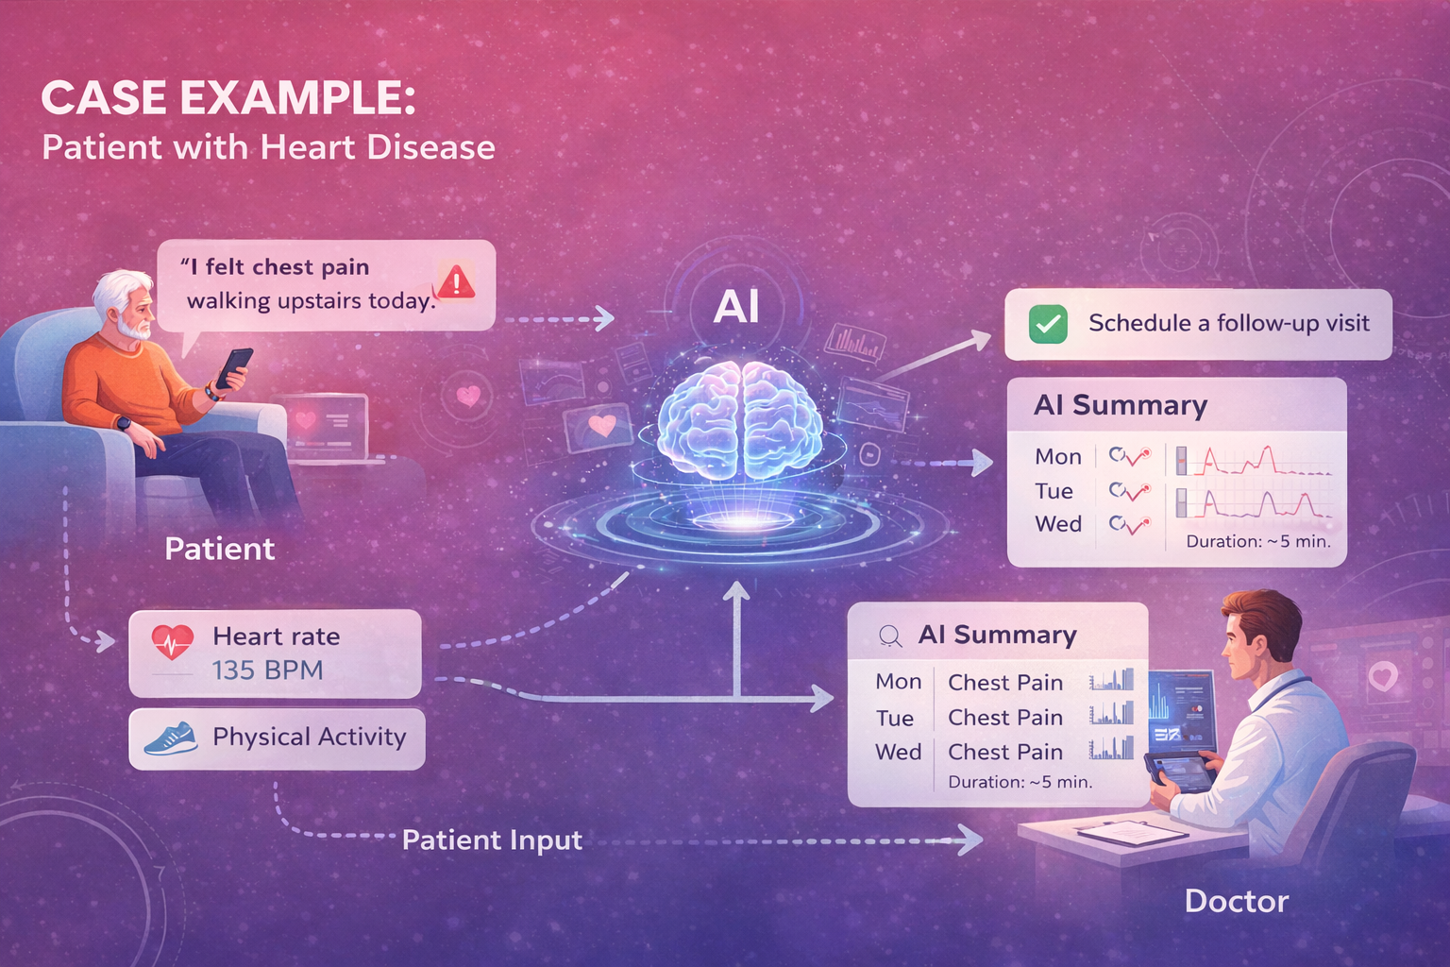
Case example old patient with heart disease
Notes:
We will now present a case example that shows how the system works in practice.

Slide 10
Case example old patient with heart disease
A 65-year-old patient with known heart disease uses a smartwatch and the app
The smartwatch continuously records:
  heart rate
  physical activity
The patient writes in the app:
  “I felt chest pain when walking upstairs today.”
⟹ This input acts as a trigger
⟹ The AI is activated:
  retrieves relevant sensor data
  analyzes the situation in context
⟹ The system detects:
  elevated heart rate during activity
  chest pain linked to exertion
⟹ The AI supports decision-making:
  recommends the patient to monitor symptoms or seek care
  generates a structured summary for the doctor
Notes:
A 65-year-old patient with heart disease uses both a smartwatch and the app.
The smartwatch continuously records heart rate and physical activity.
The patient then writes, ‘I felt chest pain when walking upstairs today.’
That journal entry triggers the AI process.
The system retrieves relevant sensor data from that time period and analyzes it in context.
It detects an elevated heart rate during activity and links the chest pain to exertion.
Based on this, the system can recommend that the patient monitor symptoms or seek care, while also generating a structured summary for the doctor.

Slide 11

THANK you!
sahandkh@kth.se
marefi@kth.se
qusaiaha@kth.se

